Slide 1
CS 5683: Algorithms & Methods for Big Data Analytics Community Detection: Overlapping Communities
Arunkumar Bagavathi
Department of Computer Science
Oklahoma State university

Slide 2
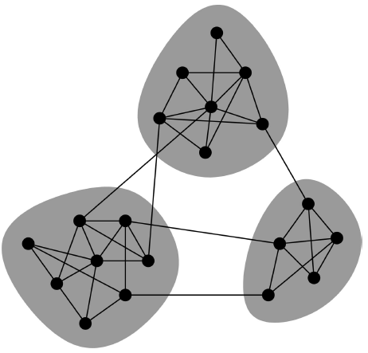
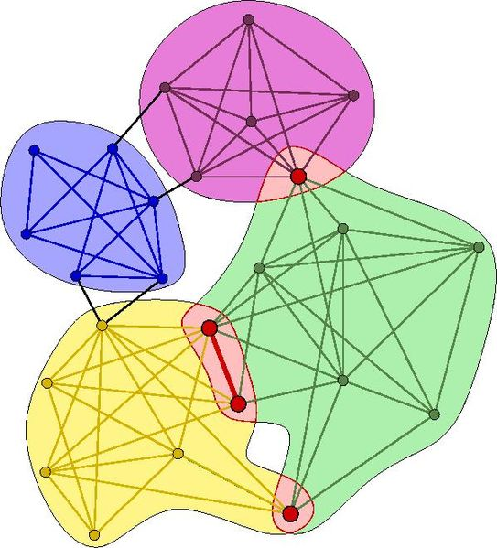
Overlapping Communities
Non-overlapping vs. Overlapping communities

Slide 3
Non-overlapping Communities
Nodes
Network
Adjacency matrix

Slide 4
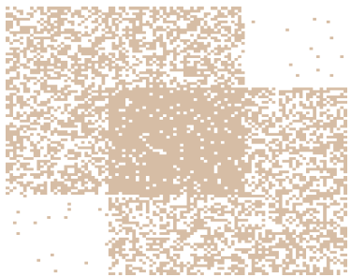
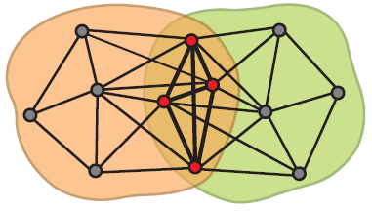
Communities as Tiles
What is the structure of community overlaps: Edge density in the overlaps is higher!
Communities as “tiles”

Slide 5

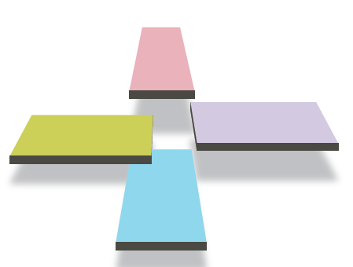
Recap so far
Communities in a network
This is what we want!

Slide 6
Plan of Attack
1) Given a model, we generate the network:
2) Given a network, find the “best” model
Generative model for networks
B
A
F
D
E
C
G
H
B
Generative model for networks
A
F
D
E
C
G
H

Slide 7
Model of Networks
Goal: Define a model that can generate networks
The model will have a set of “parameters” that we will later want to estimate (and detect communities)
Q: Given a set of nodes, how do communities “generate” edges of the network?
Generative model for networks
B
A
F
D
E
C
G
H

Slide 8


Community Affiliation Graph
Communities, C
p_{A}
p_{B}
Model
Memberships, M
Nodes, V
Model
Network
Affiliation Graph Model: Generative model B(V, C, M, {p_{c}}) for graphs:
Nodes V, Communities C, Memberships M
Each community c has a single probability p_{c}
Later we fit the model to networks to detect communities

Slide 9

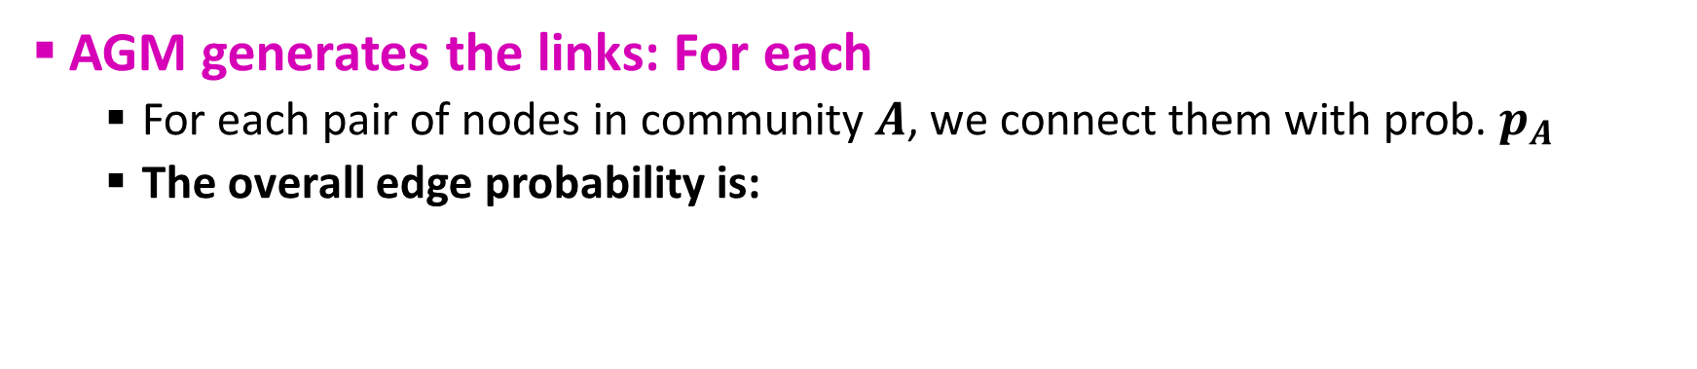

AGM: Generative Process
Communities, C
p_{A}
p_{B}
Model
Memberships, M
Nodes, V
Community Affiliations
Network
AGM generates the links: For each
For each pair of nodes in community $A$, we connect them with prob. $p_{A}$
The overall edge probability is:
$M_{u}$ … set of communities node $u$ belongs to
If $u,v$ share no communities: $P\left(u,v\right)=ε$
Think of this as an “OR” function: If at least 1 community says “YES” we create an edge

Slide 10
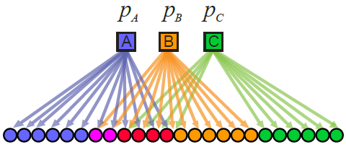
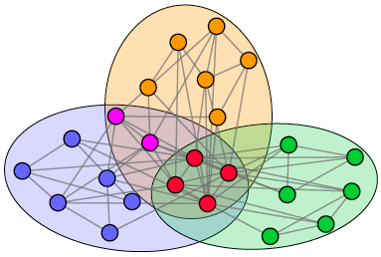
Recap: AGM Networks

Slide 11
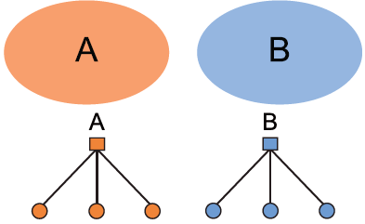
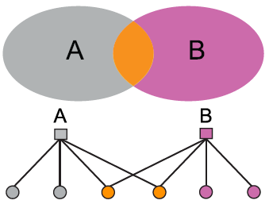
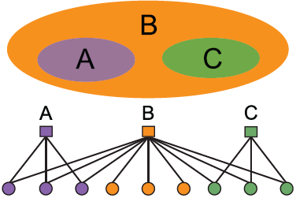
AGM: Flexibility
AGM can express a variety of community structures: Non-overlapping, Overlapping, Nested

Slide 12
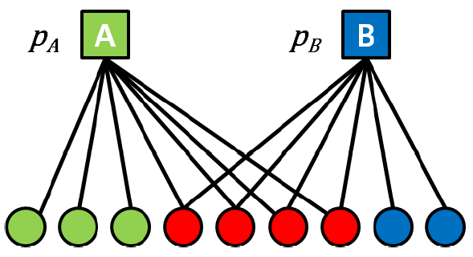

AGM: How to Detect Communities
Detecting communities with AGM:
B
A
F
D
E
C
G
H
Given a Graph $G(V,E)$, find the Model
Affiliation graph M
Number of communities C
Parameters p_{c}

Slide 13
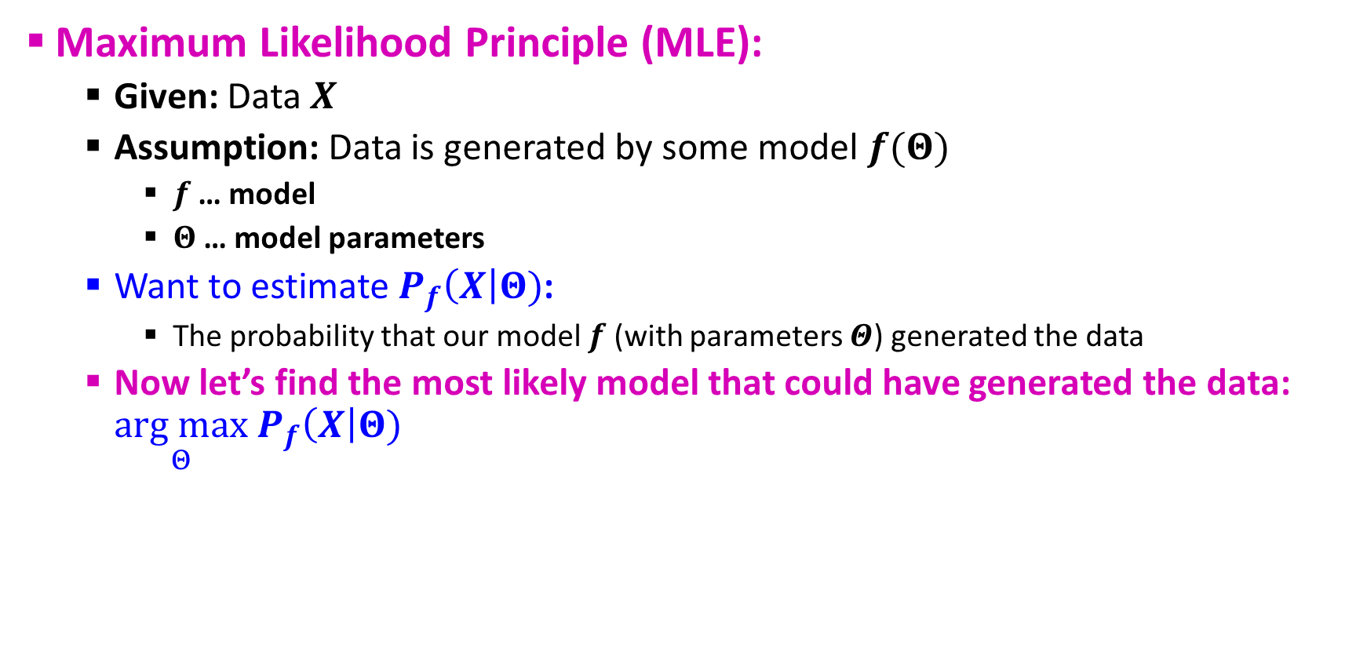
Maximum Likelihood Estimation
Maximum Likelihood Principle (MLE):
Given: Data $X$
Assumption: Data is generated by some model $f(Θ)$
$f$ … model
$Θ$ … model parameters
Want to estimate $P_{f}\left(X\right|Θ)$:
The probability that our model $f$ (with parameters $Θ$) generated the data
Now let’s find the most likely model that could have generated the data: $\underset{Θ}{arg max}{ P}_{f}\left(X\right|Θ)$

Slide 14
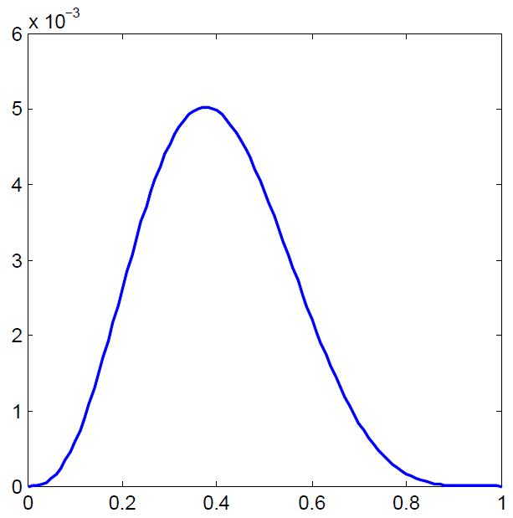


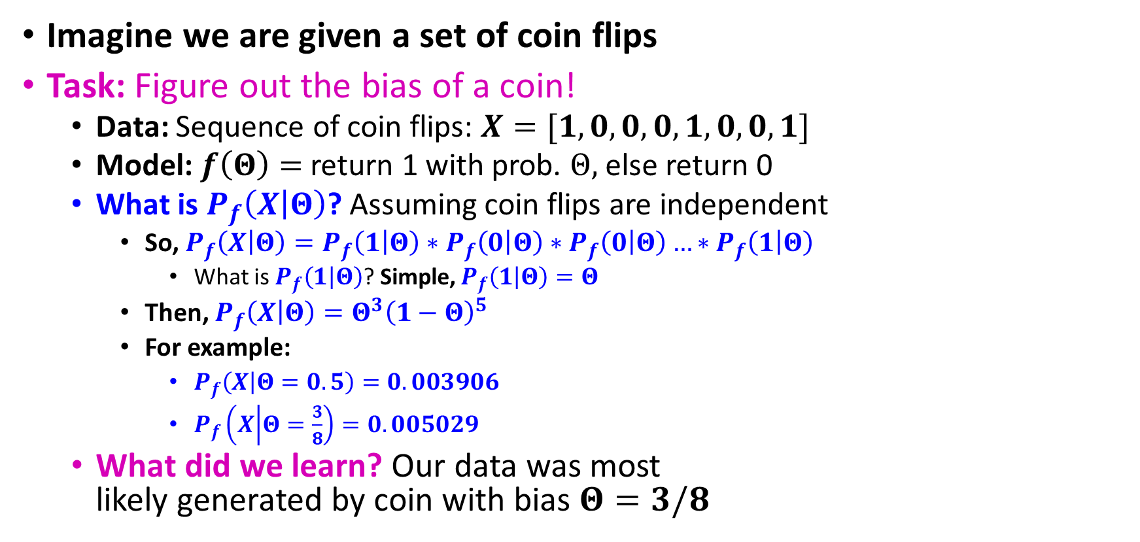
Example: MLE
Imagine we are given a set of coin flips
Task: Figure out the bias of a coin!
Data: Sequence of coin flips: $X=[1, 0, 0, 0, 1,0,0,1]$
Model: $f\left(Θ\right)=$ return 1 with prob. $Θ,$ else return 0
What is $P_{f}\left(X | Θ\right)$? Assuming coin flips are independent
So, $P_{f}\left(X | Θ\right)=P_{f}\left(1 | Θ\right)∗P_{f}\left(0 | Θ\right)∗P_{f}\left(0 | Θ\right)…∗P_{f}\left(1 | Θ\right)$
What is $P_{f}\left(1 | Θ\right)$? Simple, $P_{f}\left(1 | Θ\right)=Θ$
Then, $P_{f}\left(X | Θ\right)=Θ^{3}{\left(1−Θ\right)}^{5}$
For example:
$P_{f}\left(X | Θ=0.5\right)=0.003906$
$P_{f}\left(X | Θ=\frac{3}{8}\right)=0.005029$
What did we learn? Our data was most likely generated by coin with bias $Θ=3/8$
$$P_{f}\left(X | Θ\right)$$
$$Θ$$

Slide 15
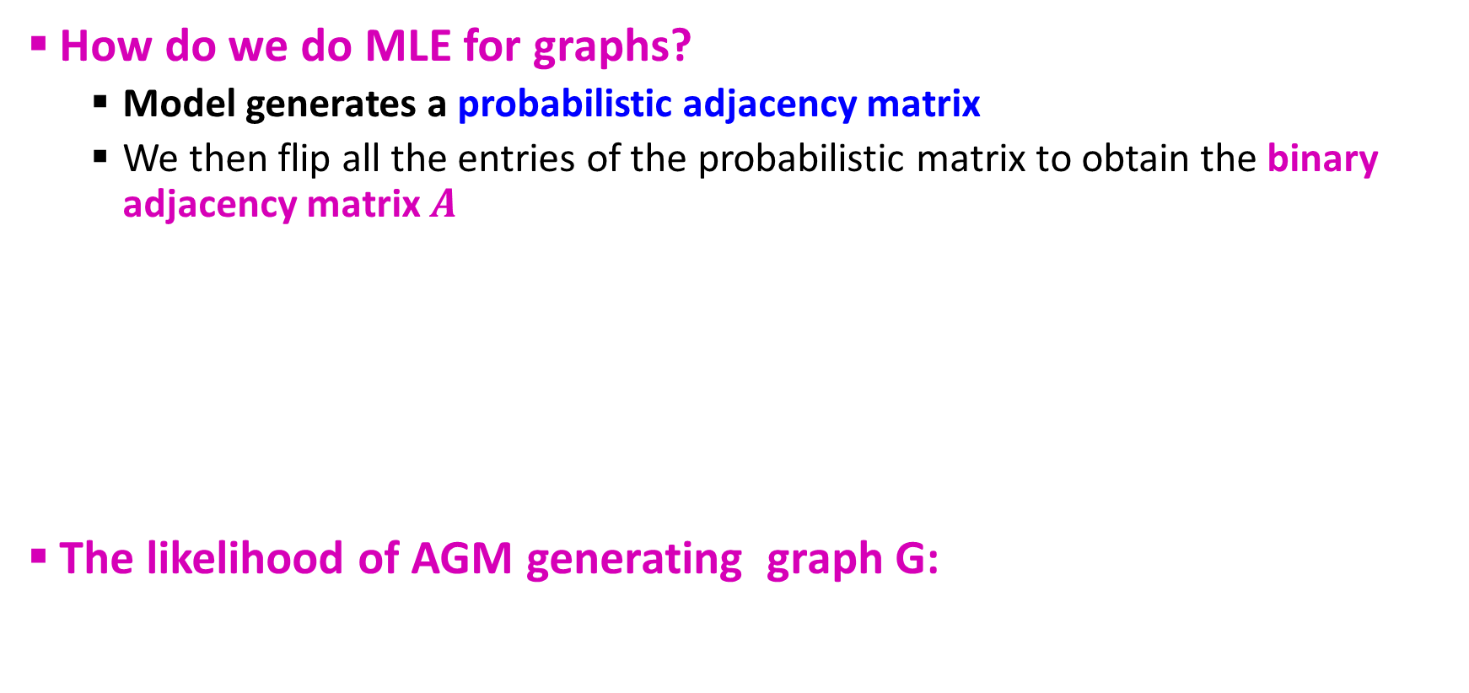

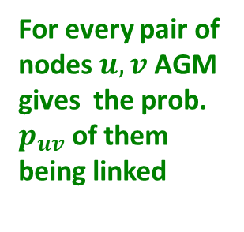
MLE for Graphs
How do we do MLE for graphs?
Model generates a probabilistic adjacency matrix
We then flip all the entries of the probabilistic matrix to obtain the binary adjacency matrix $A$
The likelihood of AGM generating graph G:
Flip biased coins
$$A$$
For every pair of nodes $u,v$ AGM gives the prob. $p_{uv}$ of them being linked
0 | 0.10 | 0.10 | 0.04
0.10 | 0 | 0.02 | 0.06
0.10 | 0.02 | 0 | 0.06
0.04 | 0.06 | 0.06 | 0
0 | 1 | 0 | 0
1 | 0 | 1 | 1
0 | 1 | 0 | 1
0 | 1 | 1 | 0

Slide 16
Graphs: Likelihood P(G|Θ)
Given graph G(V,E) and Θ, we calculate likelihood that Θ generated G: P(G|Θ)
G
0 | 0.9 | 0.9 | 0
0.9 | 0 | 0.9 | 0
0.9 | 0.9 | 0 | 0.9
0 | 0 | 0.9 | 0
0 | 1 | 1 | 0
1 | 0 | 1 | 0
1 | 1 | 0 | 1
0 | 0 | 1 | 0
A
B
Θ=B(V, C, M, {p_{c}})
G
P(G|Θ)

Slide 17
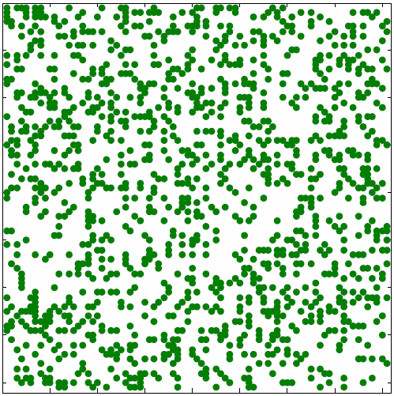
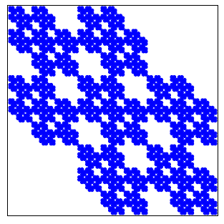



MLE for Graphs
Our goal: Find $Θ=B(V,C,M,\left\{p_{C}\right\})$ such that:
How do we find $B(V,C,M,\left\{p_{C}\right\})$ that maximizes the likelihood?
P(
|
)
$$G$$
AGM
arg max

Slide 18
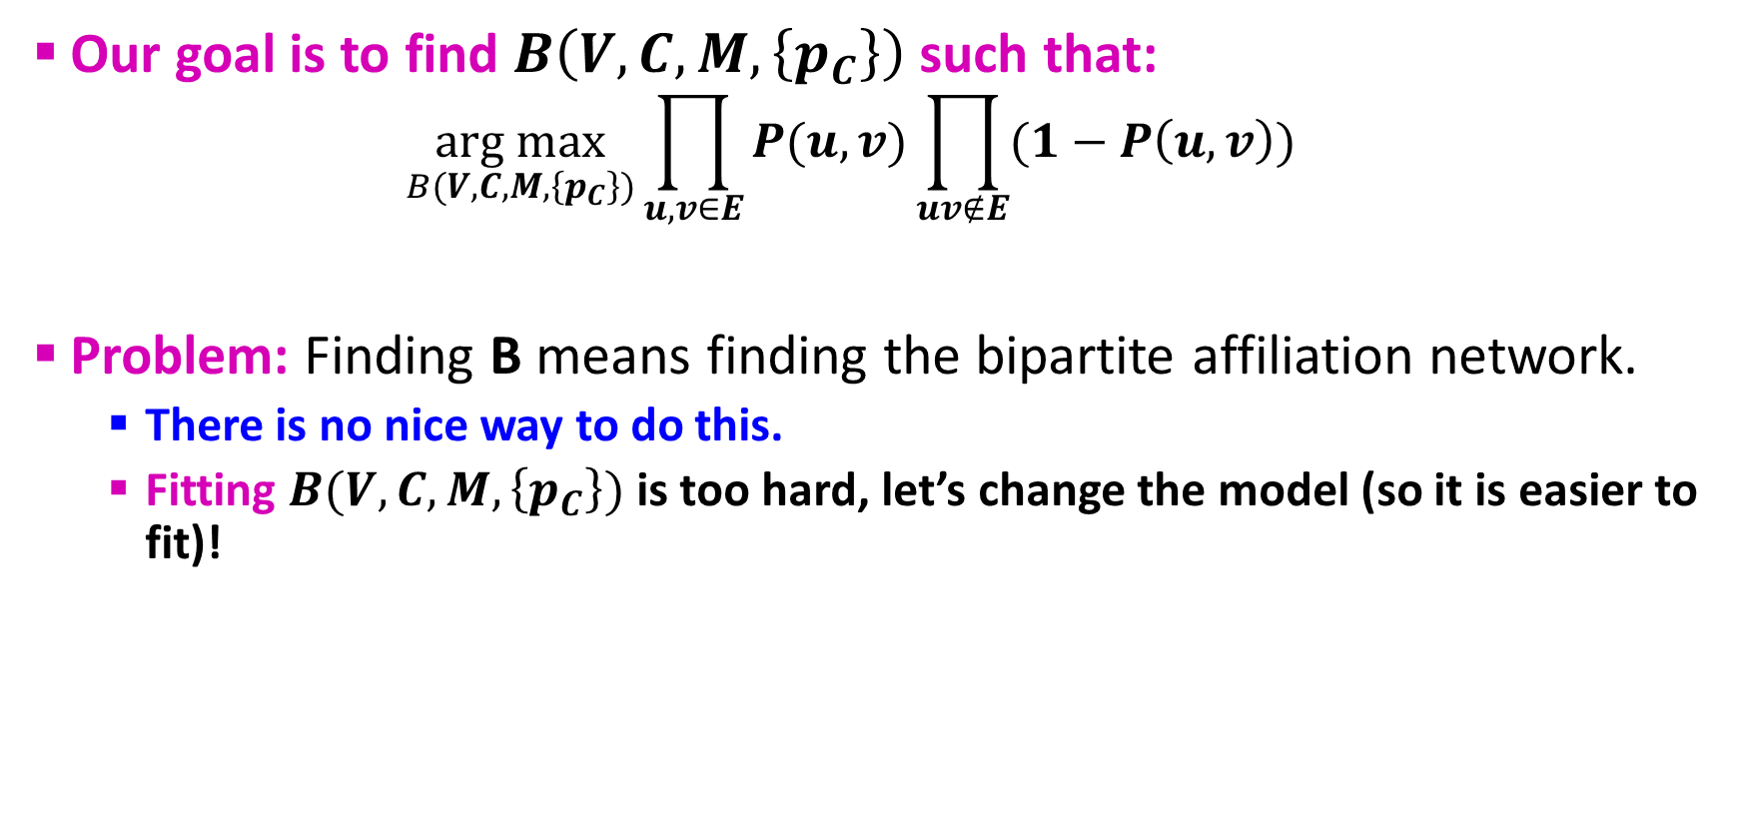
MLE for AGM
Our goal is to find $B\left(V,C,M,\left\{p_{C}\right\}\right)$ such that:
$$\underset{B(V,C,M,\left\{p_{C}\right\})}{arg max}{\prod_{u,v∈E}{P(u,v){\prod_{uv∉E}{(1−P\left(u,v\right)})}^{}}}$$
Problem: Finding B means finding the bipartite affiliation network.
There is no nice way to do this.
Fitting $B(V,C,M,\left\{p_{C}\right\})$ is too hard, let’s change the model (so it is easier to fit)!

Slide 19

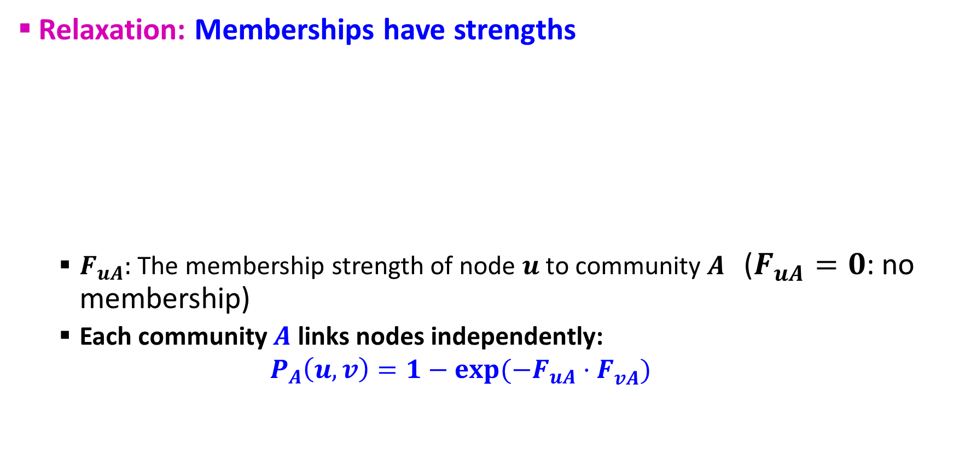
From AGM to BigCLAM
Relaxation: Memberships have strengths
$F_{uA}:$ The membership strength of node $u$ to community $A$ ($F_{uA}=0$: no membership)
Each community $A$ links nodes independently:
$$P_{A}\left(u,v\right)=1−exp⁡(−F_{uA}⋅F_{vA}^{})$$
$$F_{uA}$$

Slide 20




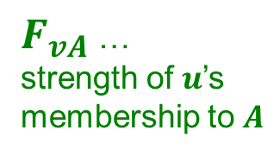
Factor Matrix F
Community membership strength matrix $F$
Communities
$P_{A}\left(u,v\right)=1−exp⁡(−F_{uA}⋅F_{vA}^{})$
Probability of connection is proportional to the product of strengths
Notice: If one node doesn’t belong to the community ($F_{uC}=0$) then $P(u,v)=0$
Prob. that at least one common community $C$ links the nodes:
$P\left(u,v\right)=1−\prod_{C}{\left(1−P_{C}\left(u,v\right)\right)}$
Nodes
 | j
$$F=$$
$F_{u}$ … vector of
community membership strengths of $u$
$F_{vA}$ …
strength of $u$’s membership to $A$

Slide 21
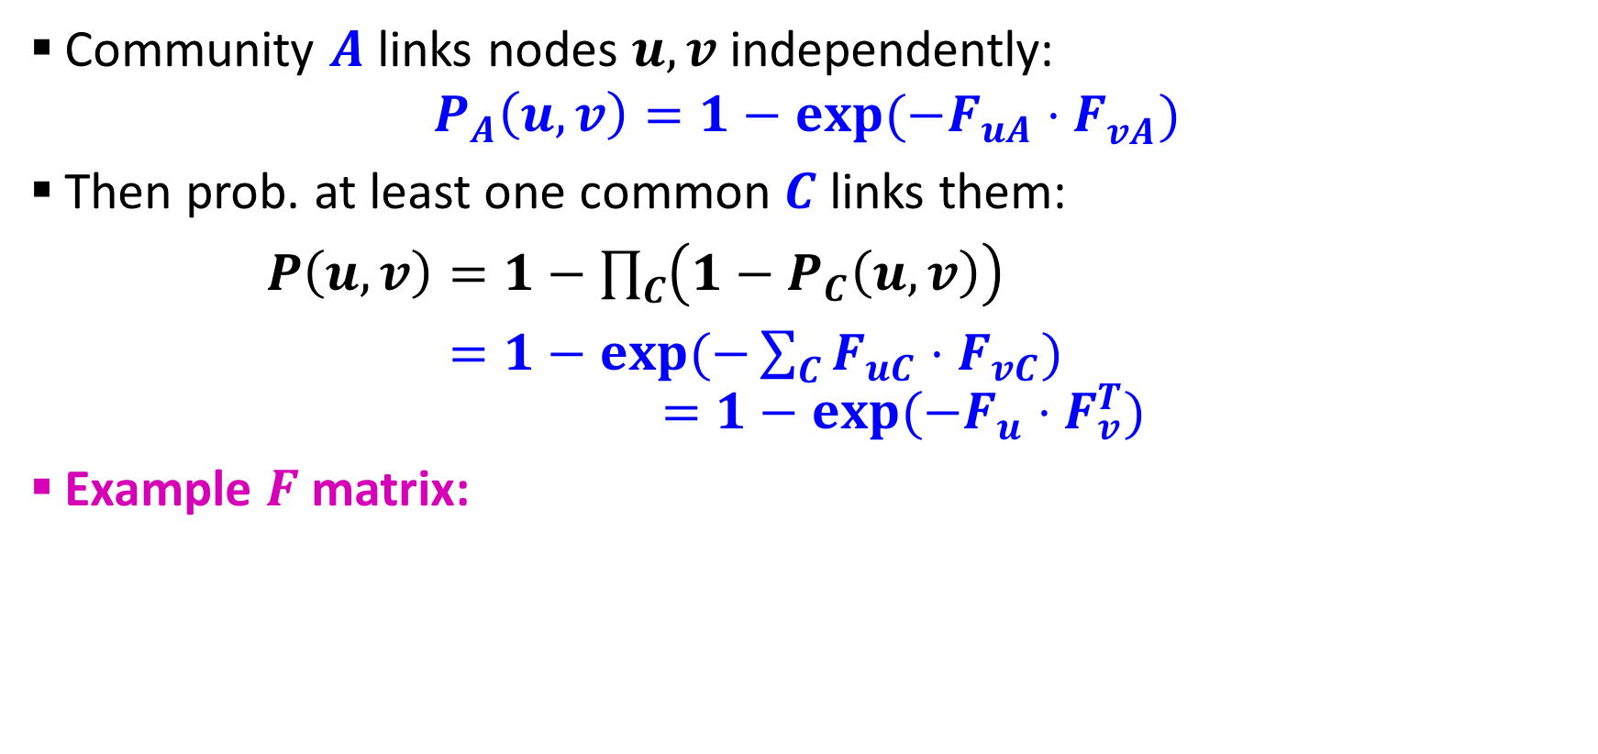
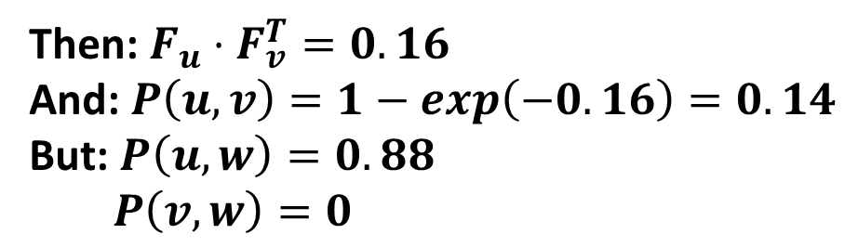



From AGM to BigCLAM
Community $A$ links nodes $u,v$ independently: $P_{A}\left(u,v\right)=1−exp⁡(−F_{uA}⋅F_{vA}^{})$
Then prob. at least one common $C$ links them:
$P\left(u,v\right)=1−\prod_{C}{\left(1−P_{C}\left(u,v\right)\right)}$
$=1−exp⁡(−\sum_{C}{F_{uC}⋅F_{vC}})$
$$=1−exp⁡(−F_{u}⋅F_{v}^{T})$$
Example $F$ matrix:
$$F_{u}^{}:$$
0 | 1.2 | 0 | 0.2
Then: $F_{u}⋅F_{v}^{T}=0.16$
And: $P\left(u,v\right)=1−exp\left(−0.16\right)=0.14$
But: $P\left(u,w\right)=0.88$
$P\left(v,w\right)=0$
Node
community membership
strengths
$$F_{v}^{}:$$
0.5 | 0 | 0 | 0.8
$$F_{w}^{}:$$
0 | 1.8 | 1 | 0

Slide 22
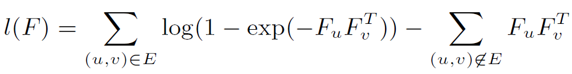
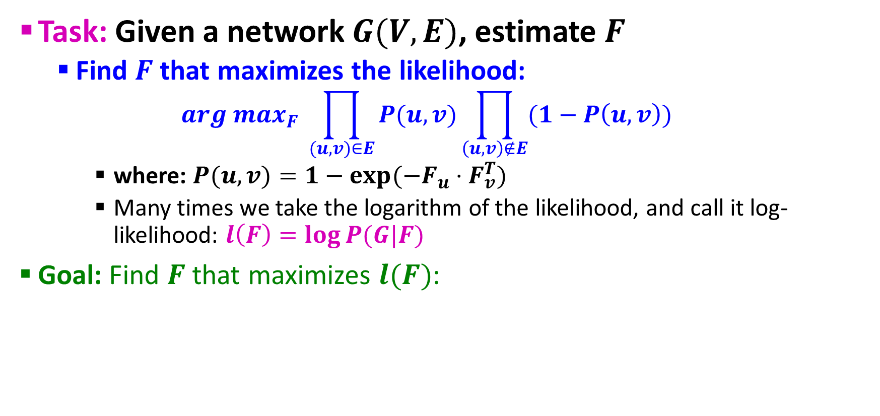
BigCLAM: How to Find F
Task: Given a network $G(V,E)$, estimate $F$
Find $F$ that maximizes the likelihood:
$$arg max_{F} \prod_{(u,v)∈E}{P(u,v})\prod_{\left(u,v\right)∉E}{(1−P\left(u,v\right))}$$
where: $P(u,v)=1−exp⁡(−F_{u}⋅F_{v}^{T})$
Many times we take the logarithm of the likelihood, and call it log-likelihood: $l\left(F\right)=log⁡P(G|F)$
Goal: Find $F$ that maximizes $l(F)$:

Slide 23

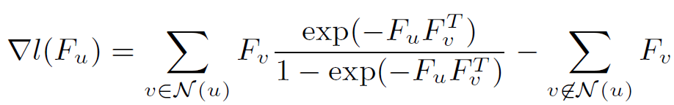
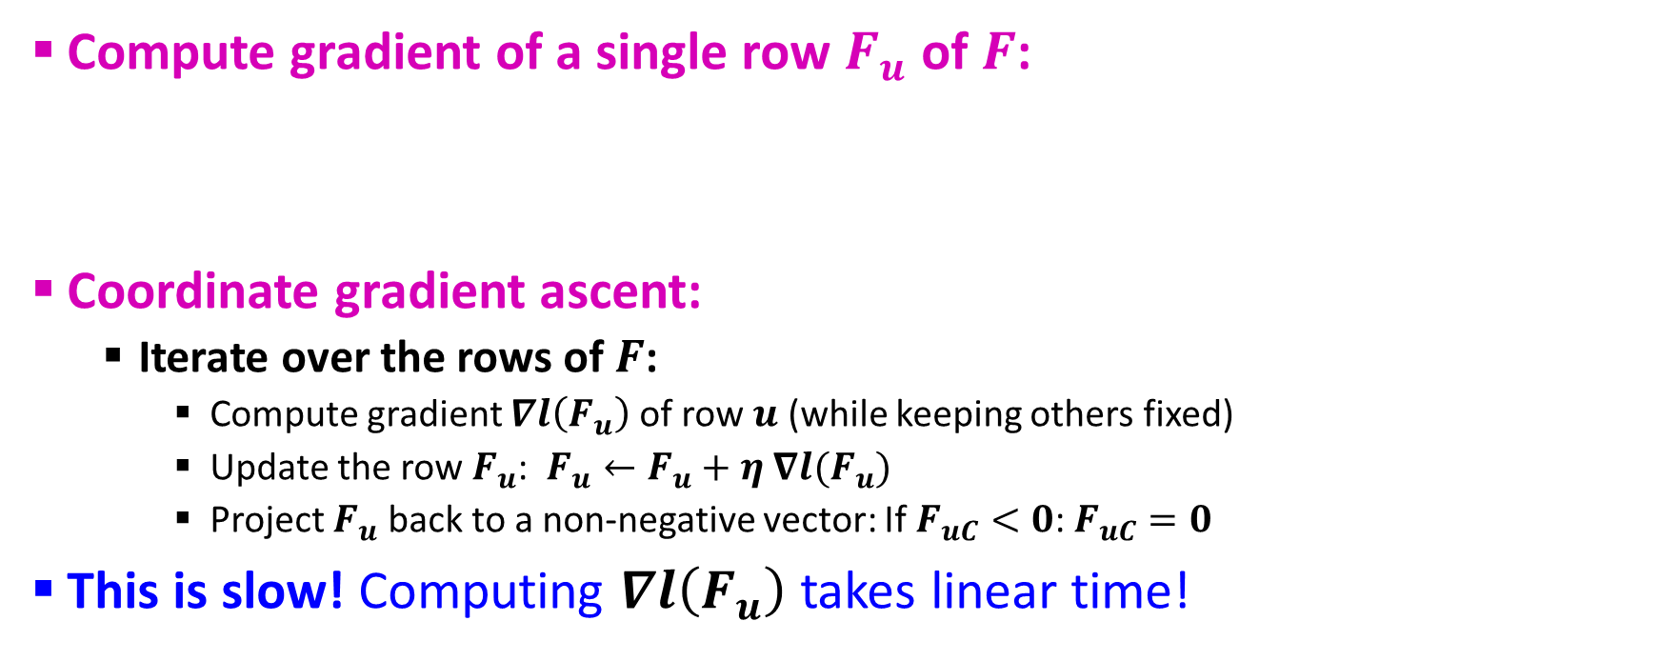
BigCLAM: V1.0
Compute gradient of a single row $F_{u}$ of $F$:
Coordinate gradient ascent:
Iterate over the rows of $F$:
Compute gradient $∇l\left(F_{u}\right)$ of row $u$ (while keeping others fixed)
Update the row $F_{u}$: $F_{u}←F_{u}+η ∇l(F_{u})$
Project $F_{u}$ back to a non-negative vector: If $F_{uC}<0$: $F_{uC}=0$
This is slow! Computing $∇l\left(F_{u}\right)$ takes linear time!

Slide 24
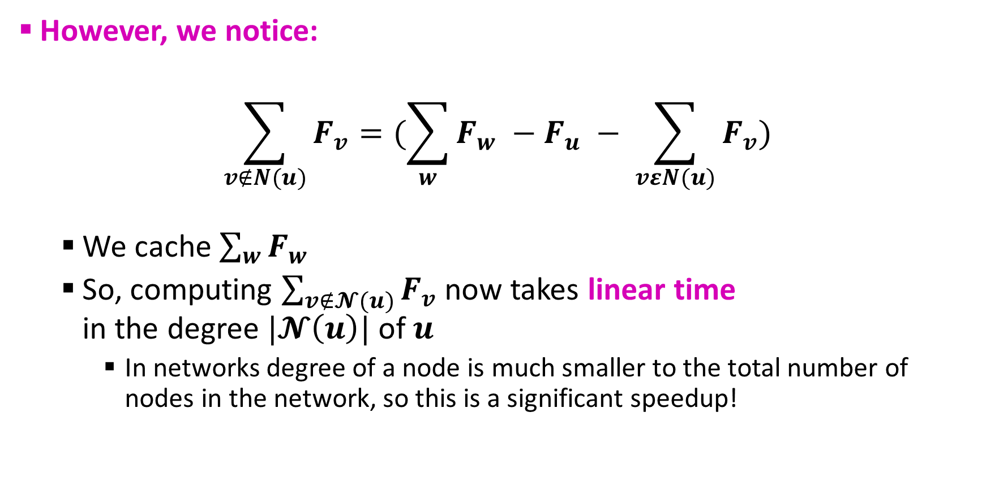
BigCLAM: V2.0
However, we notice:
$$\sum_{v∉N(u)}{F_{v}=(\sum_{w}{F_{w} −F_{u} − \sum_{vεN(u)}{F_{v}}})}$$
We cache $\sum_{w}{F_{w}}$
So, computing $\sum_{v∉𝓝(u)}{F_{v}}$ now takes linear time in the degree $|𝓝\left(u\right)|$ of $u$
In networks degree of a node is much smaller to the total number of nodes in the network, so this is a significant speedup!

Slide 25
BigCLAM: Scalability
BigCLAM takes 5 minutes for 300k node nets
Other methods take 10 days
Can process networks with 100M edges!

Slide 26
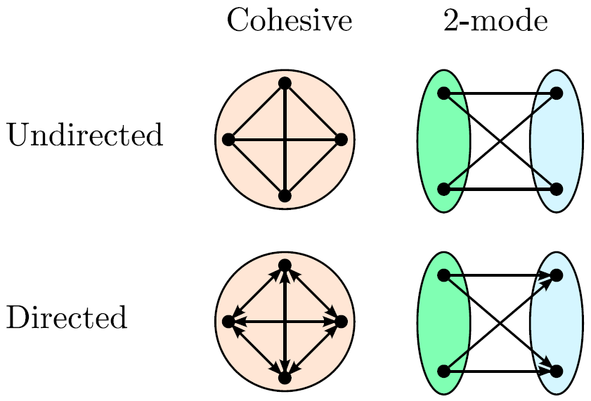
Extension: Directed Memberships

Slide 27
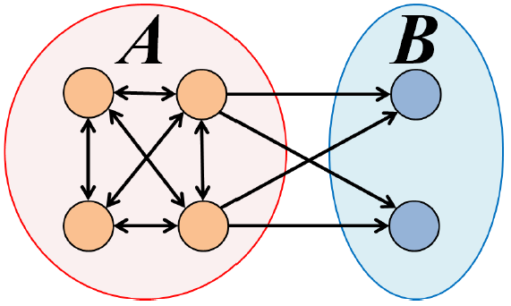
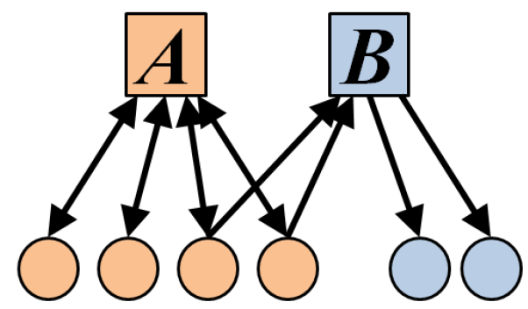
Extension: Directed AGM
Extension: Make community membership edges directed!
Outgoing membership: Nodes “sends” edges
Incoming membership: Node “receives” edges

Slide 28
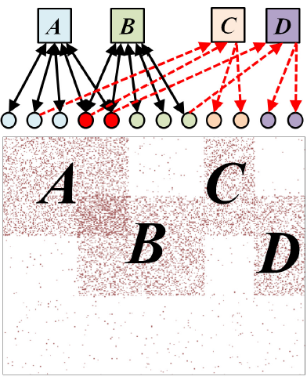
Example: Model and Network

Slide 29


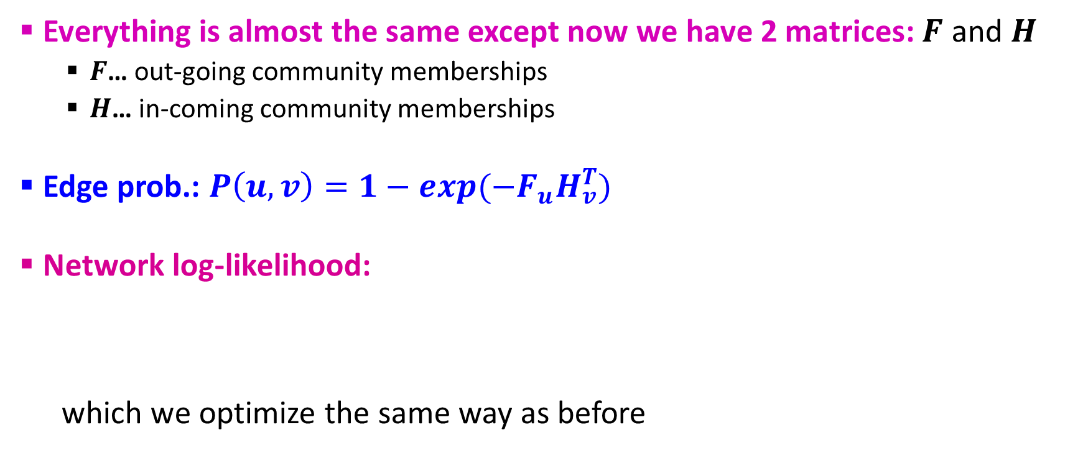
Directed AGM
Everything is almost the same except now we have 2 matrices: $F$ and $H$
$F$… out-going community memberships
$H$… in-coming community memberships
Edge prob.: $P\left(u,v\right)=1−exp(−F_{u}H_{v}^{T})$
Network log-likelihood:
which we optimize the same way as before

Slide 30
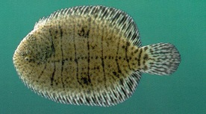
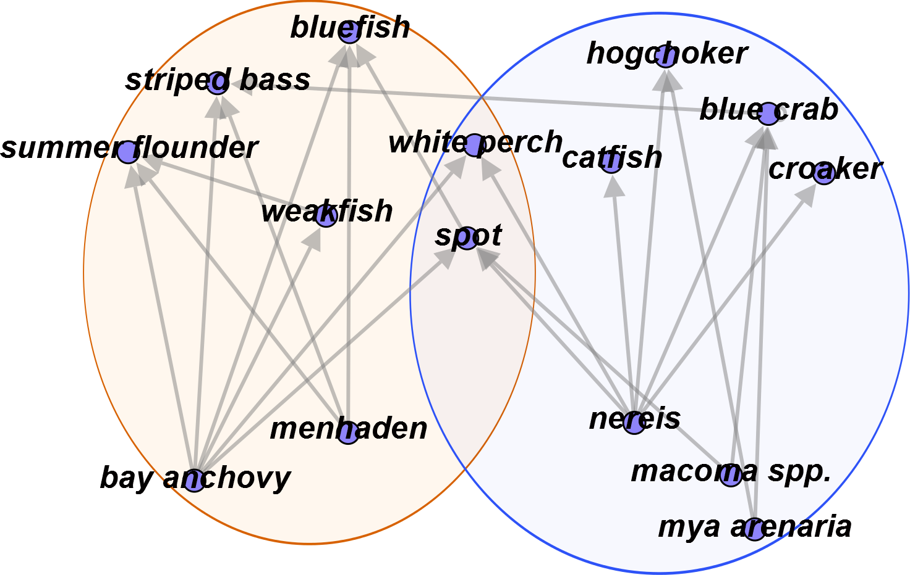
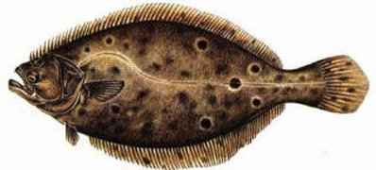
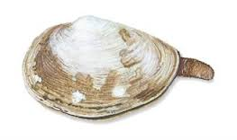
Predator-Prey Communities

Slide 31

Questions???

Slide 32
Acknowledgements
Most of this lecture slides are obtained from the Mining Massive Datasets course: http://www.mmds.org/
Overlapping Community Detection at Scale: A Nonnegative Matrix Factorization Approach by J. Yang, J. Leskovec. ACM International Conference on Web Search and Data Mining (WSDM), 2013.
Detecting Cohesive and 2-mode Communities in Directed and Undirected Networks by J. Yang, J. McAuley, J. Leskovec. ACM International Conference on Web Search and Data Mining (WSDM), 2014.
Community Detection in Networks with Node Attributes by J. Yang, J. McAuley, J. Leskovec. IEEE International Conference On Data Mining (ICDM), 2013.

